Slide 1
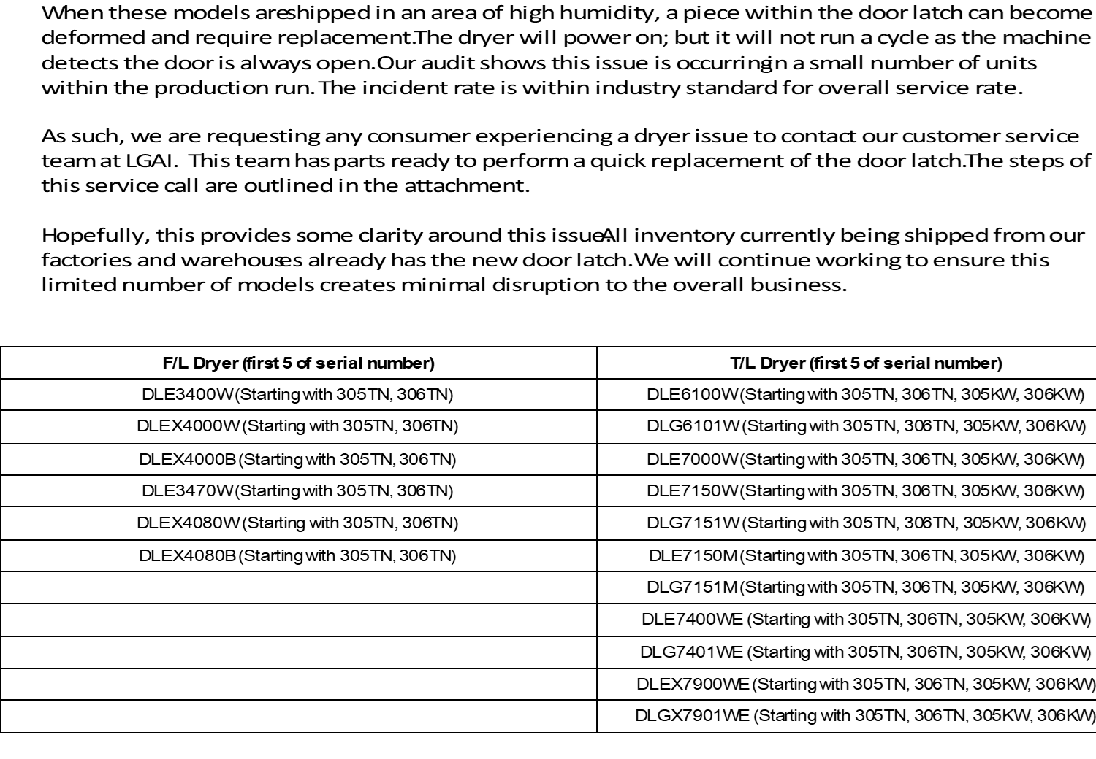
Models Impacted by Serial Number

Slide 2
Customer Service Action Plan
AI started a customer care program (providing 2 additional warranty or paying $200 cash check) since last Friday.
Over the past weekend, 17 customers had service for the dryer issue. 90% of them accepted repair with additional 2 years warranty extension
We have plenty of good dryer switches “In Stock” to take care of the issue quickly.
We should have a plan for third party service companies as well as self servicing dealers

Slide 3
What Next?
If you have customers experience the “No Start” on the dryer please have them contact the customer service number immediately.
We will dispatch a DMST fast with the part to fix the issue and offer the customer a 2 year warranty or $200 check.
Review your dealers inventory using the model number and serial number list provided.
If dealer has impacted units in stock we will RA those units for a credit
Get a new PO for the exact models that are being sent back so we can replenish inventory with new product

Slide 4
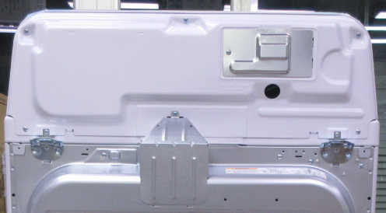
Door Latch Replacement Guide
1. Remove the Safety Cover (**Steam model only) i). Remove the one Safety cover Screw ii) Press both sides of the safety cover and pull it to the back to remove it.
Page 1

Slide 5
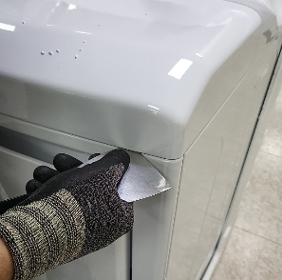
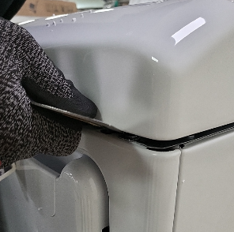
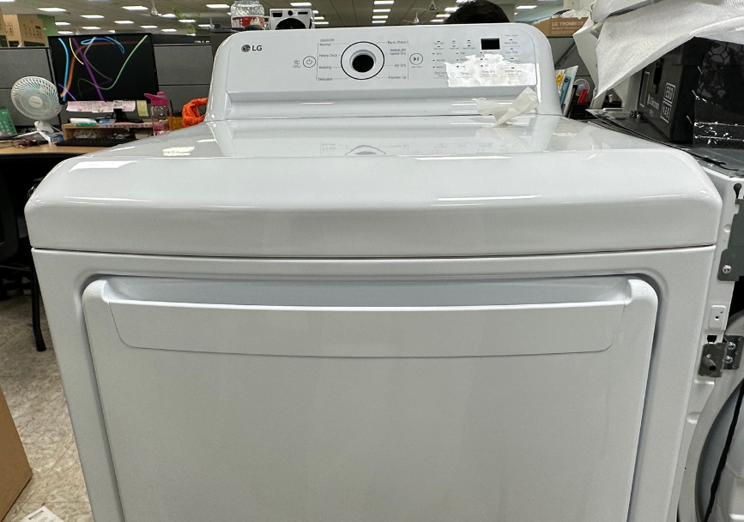
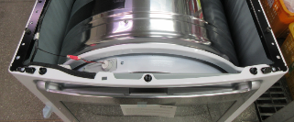
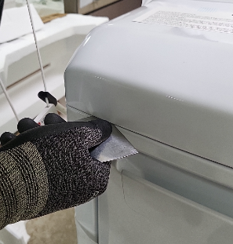
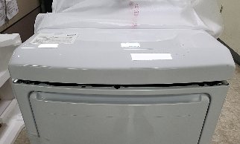
Door Latch Replacement Guide
2. Remove Top cover i).. Using a ply tool, press the left triangle holder (as if poking) Lift the left side of the Top Cover. iv). On the right side, use ply tool to press the triangle holder to lift the Top Cover.
*Reference
i) Location of triangle holder
Press the triangle holder left & right side
using ply tool
Triangle holder
After
1
2
Page 2

Slide 6
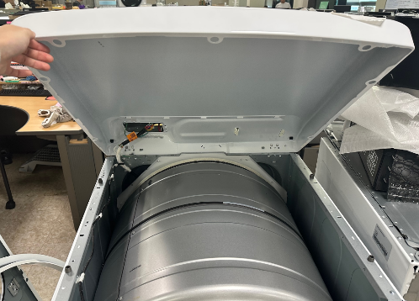
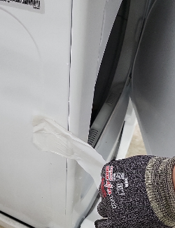
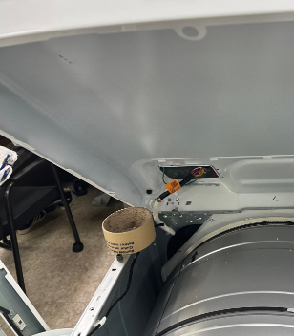
Door Latch Replacement Guide
3-1. Fix the top cover, remove the tape i) Lift the disassembled top cover. ii) Use an item to hold/prop top cover in place (ex. roll of tape)
3-2. Remove Door Tape i). Remove half of the door tape to open the door.
Page 3

Slide 7
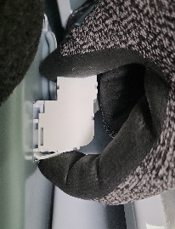
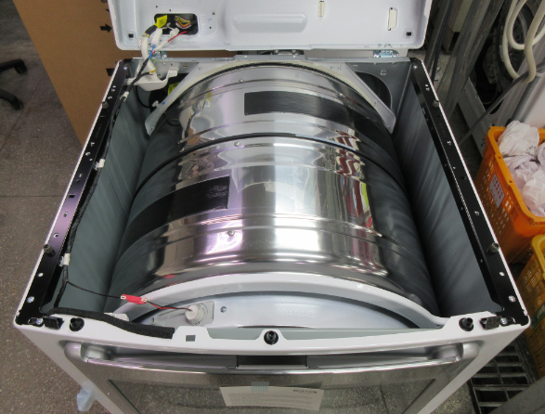
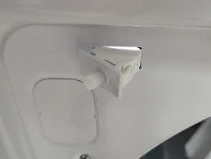
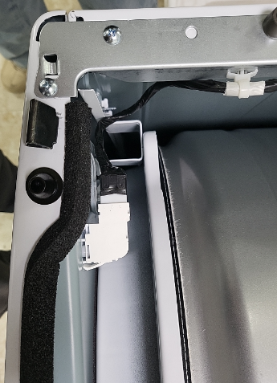
Door Latch Replacement Guide
4. Door Switch-Housing – Harness Separation i). Pull the Door Switch-Housing and remove it.
5-1. Disassemble and replace the Door Switch i). After pressing the hook of the door switch, push it forward. ii). Remove the missing hook from the front.
Housing
Door S/W
Page 4

Slide 8
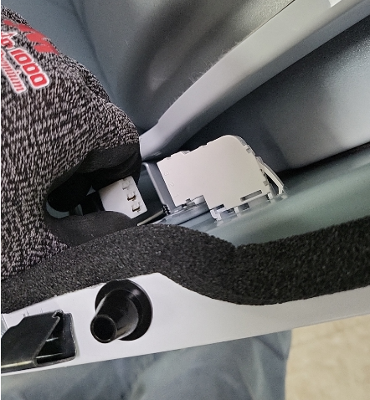
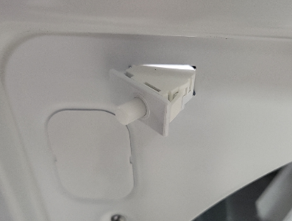
Door Latch Replacement Guide
6. Disassemble and replace the Door Switch i). ** Insert the door hook to be replaced so that it clicks from the front direction. (Assemble so that the housing assembly is on the left side of the front) ** Direction
7. Door SW – Harness Assembly i). Assemble the housing on the door switch. ** Pay attention to direction
Front side
Page 5

Slide 9
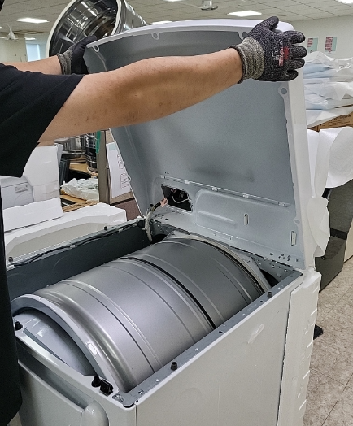
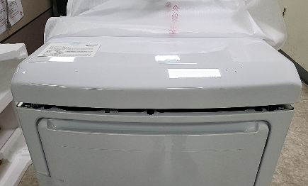
Door Latch Replacement Guide
8. Reassemble the product ii) Press the top cover from above to close it.
*The product door will remain open
Page 6

