Slide 1

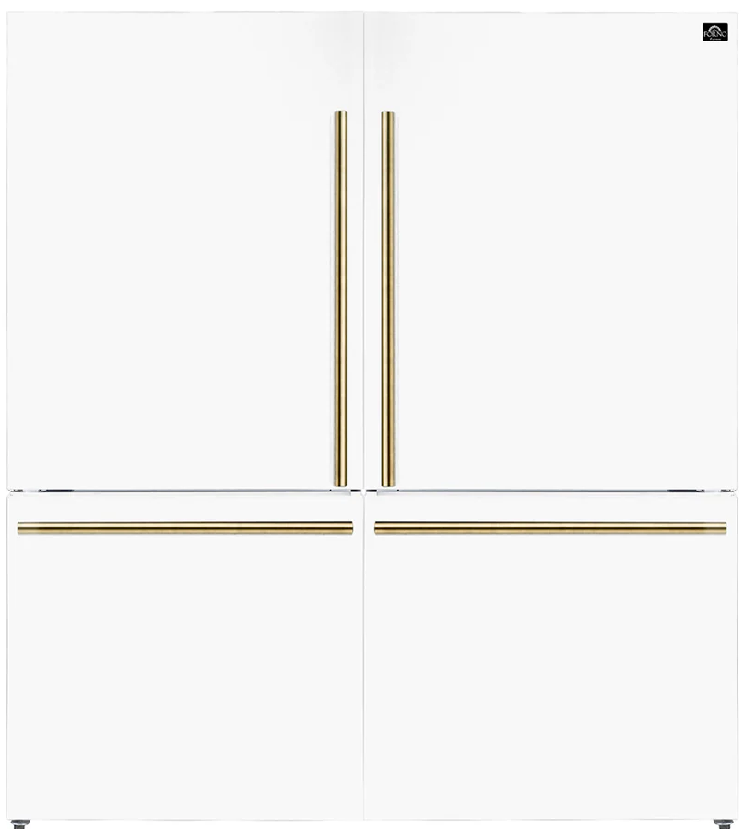
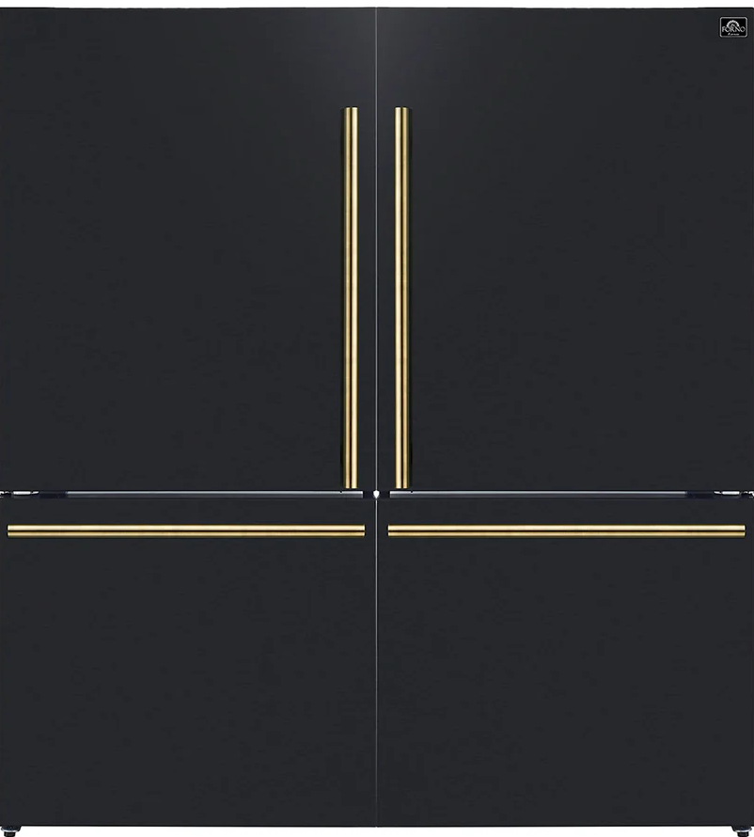
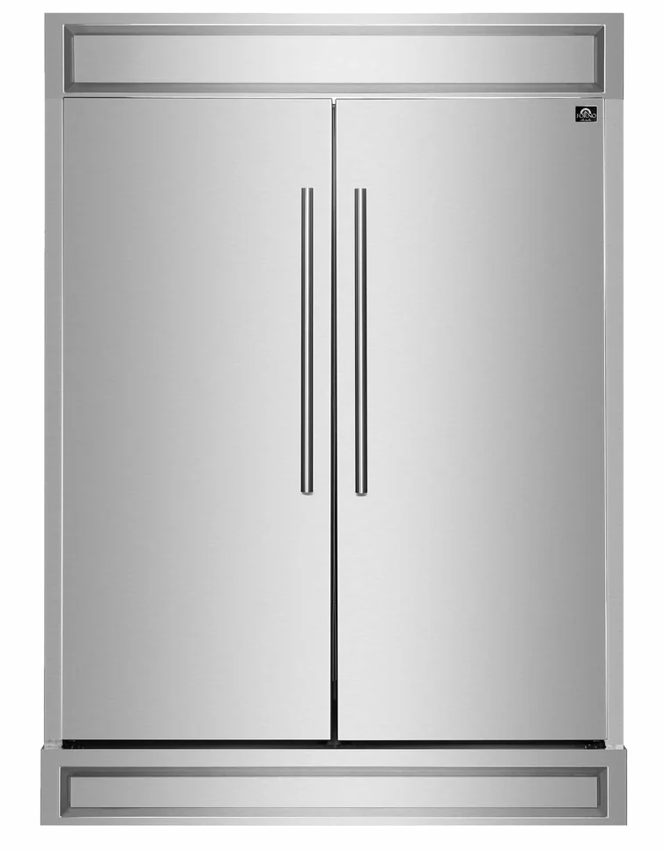
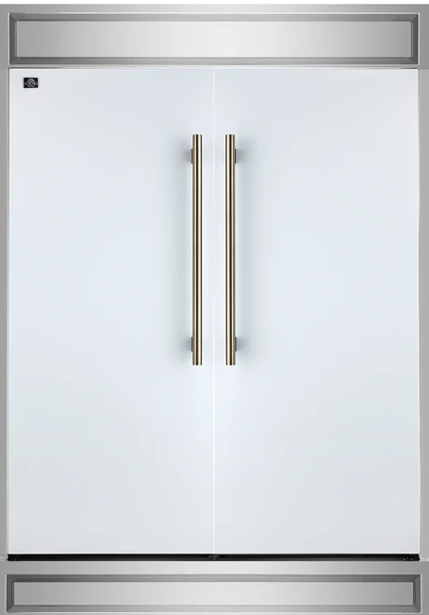
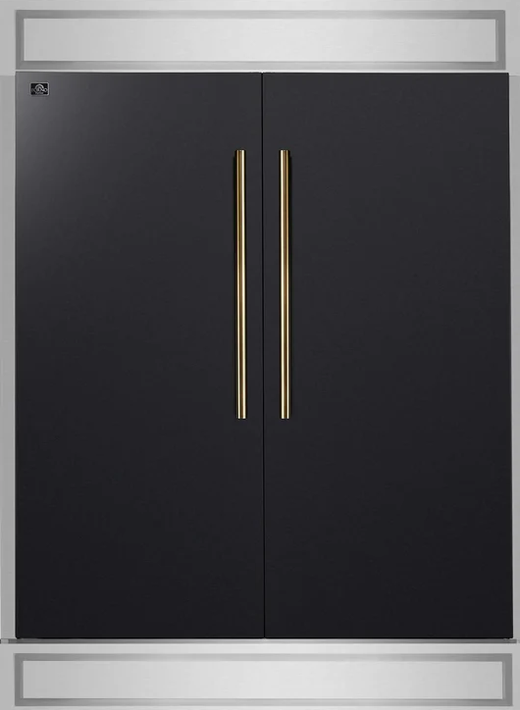
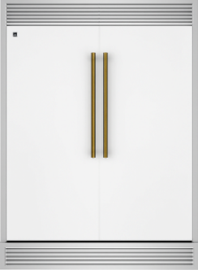
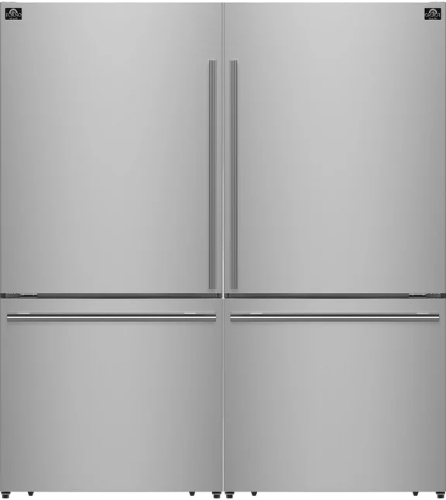
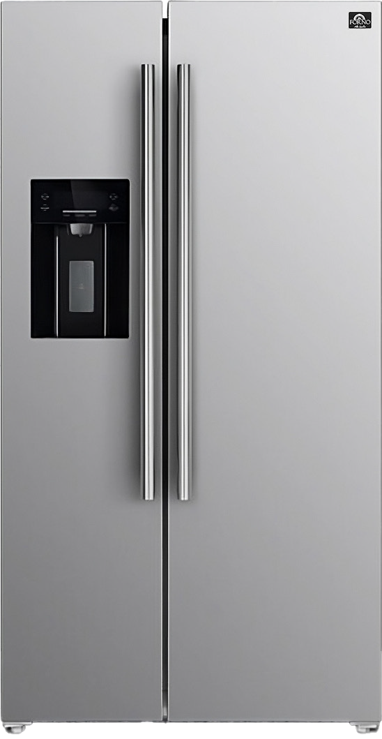
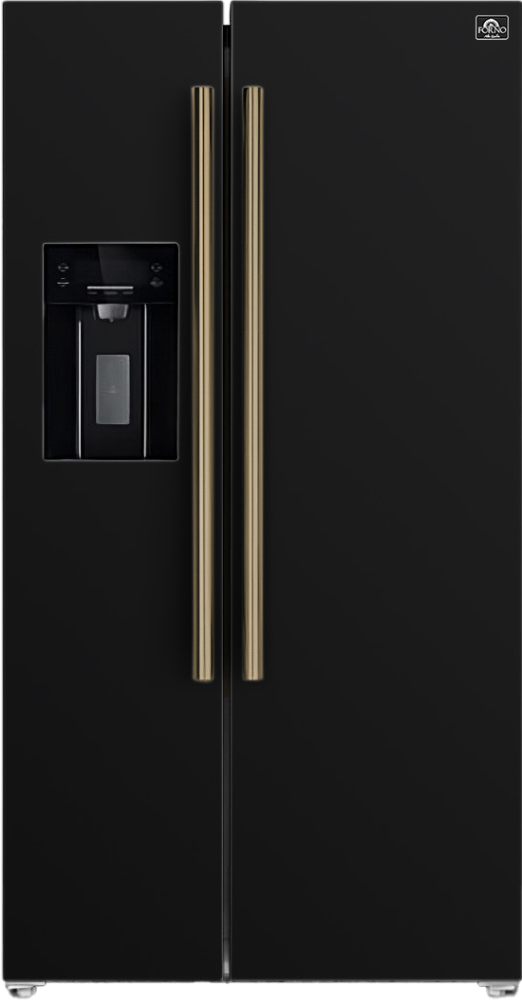
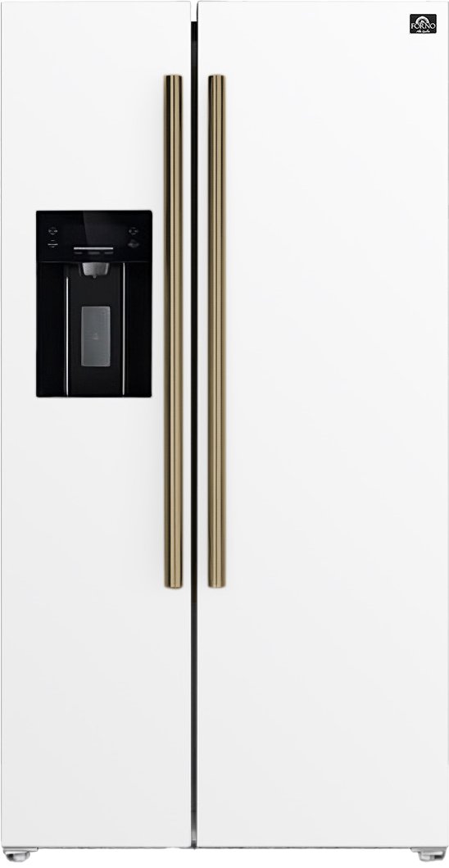
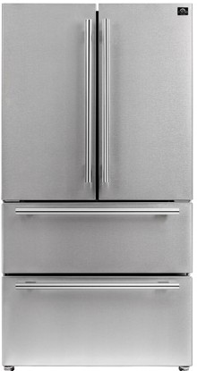
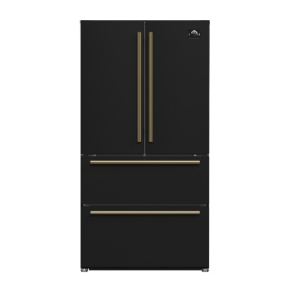
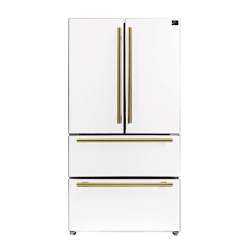
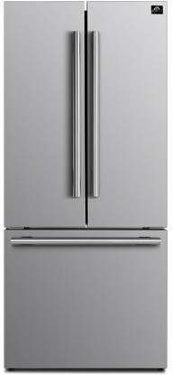
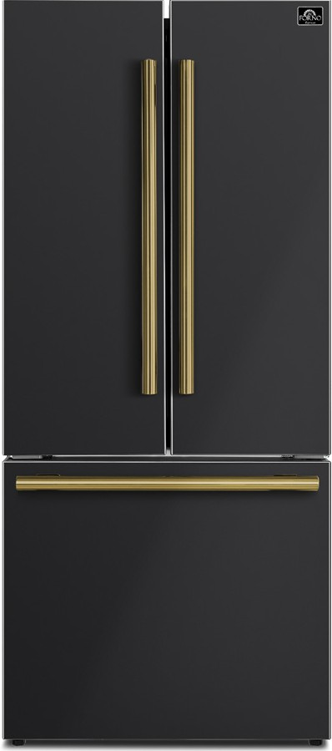
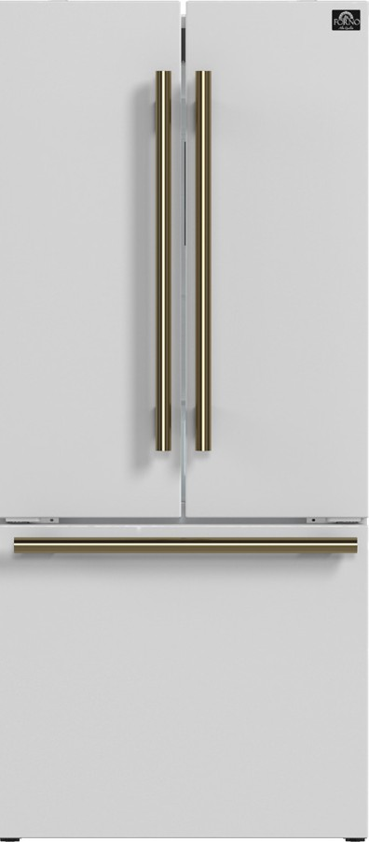
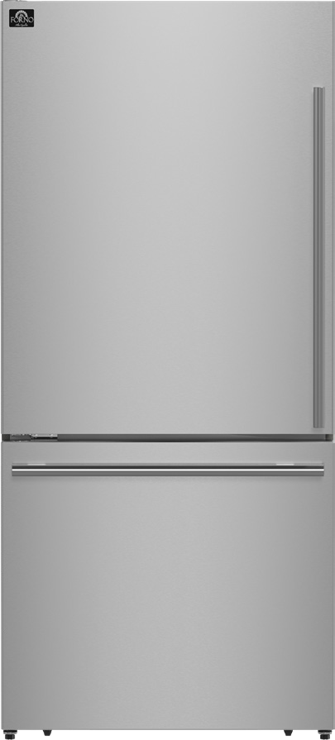
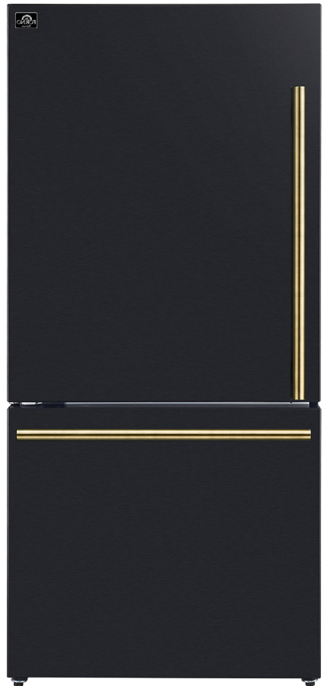
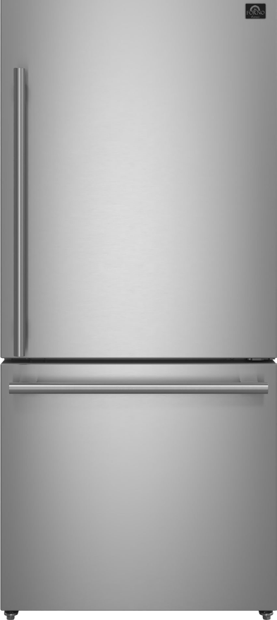
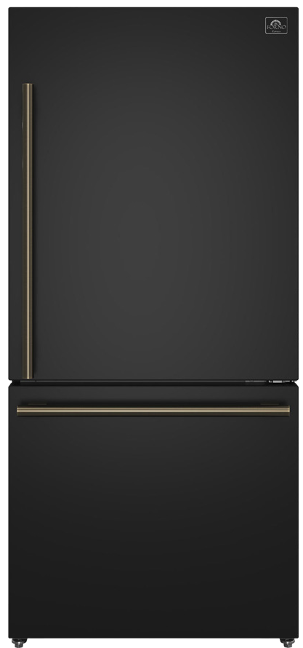
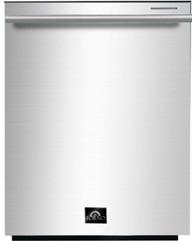

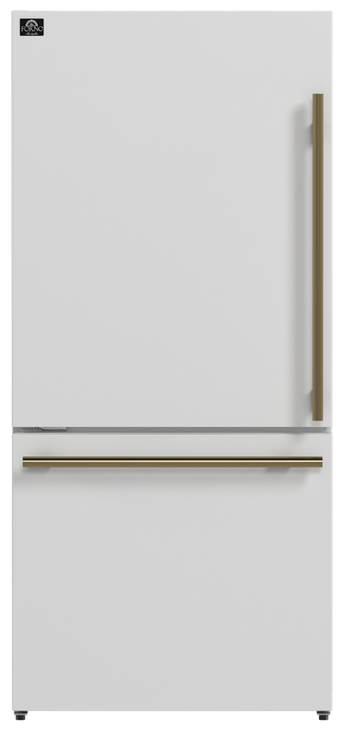
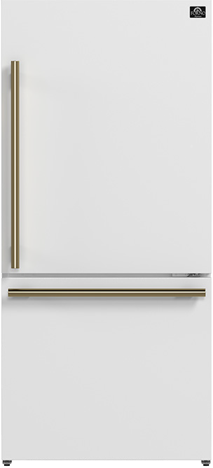
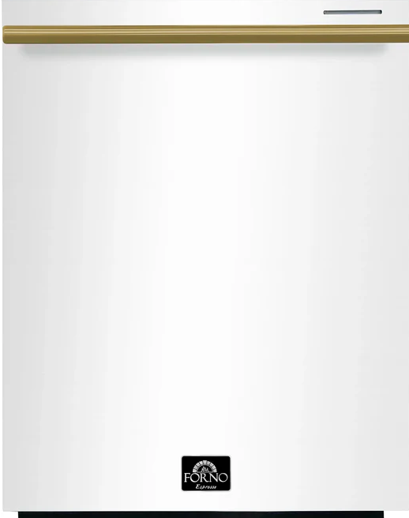

Refrigeration & Dish
$2,599/$2,799
FFFFD1787-60
60-Inch 2-Piece bottom freezer
$2,999 MAP
FFFFD1722-60S
60-Inch Maderno 2-Piece Refrigerator/Freezer Convertible Built in w/Modern Trim
$2,999 MAP
FFFFD1722-60SG
60-Inch Maderno 2-Piece Refrigerator/Freezer Convertible Built in w/Grill Trim
$1,499/$2,399
FFRBI1844-36S/B/W
36” Side by Side
$1,799/$2,199
FFRBI1820-36SB/B/W
36” Counter-Depth
4-Door French Door with Ice Maker
$1,099/$1,699
FFFFD1974-31SB/B/W
30” French Door with Ice
$899/$999
FDWBI8067-24S
24” Dishwasher with Top Control and 3rd Rack -- Stainless
$1,599/$1,699
FFFFD1786-31S/B/W
31” Left swing bottom Mount with ice
$1,099/$1,199/$1,299
FFFFD1785-31S/B/W
31” Right swing bottom Mount Refrigerator

Slide 2
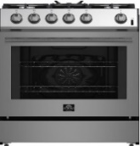
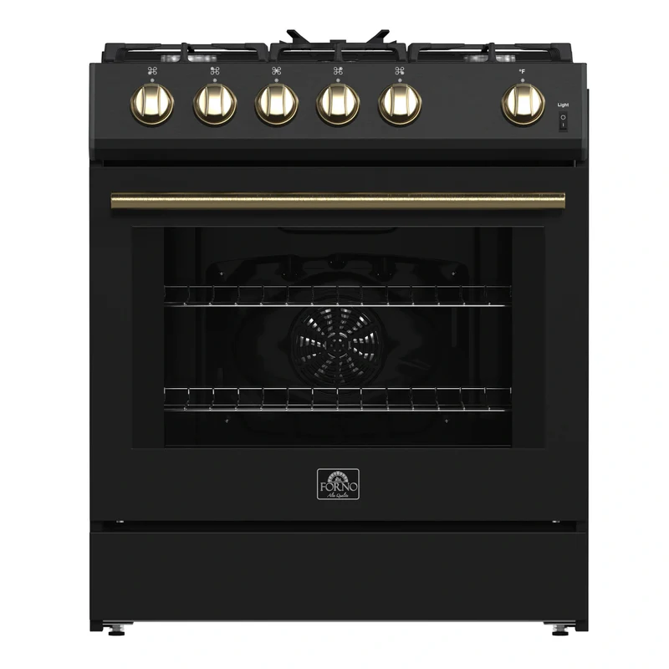
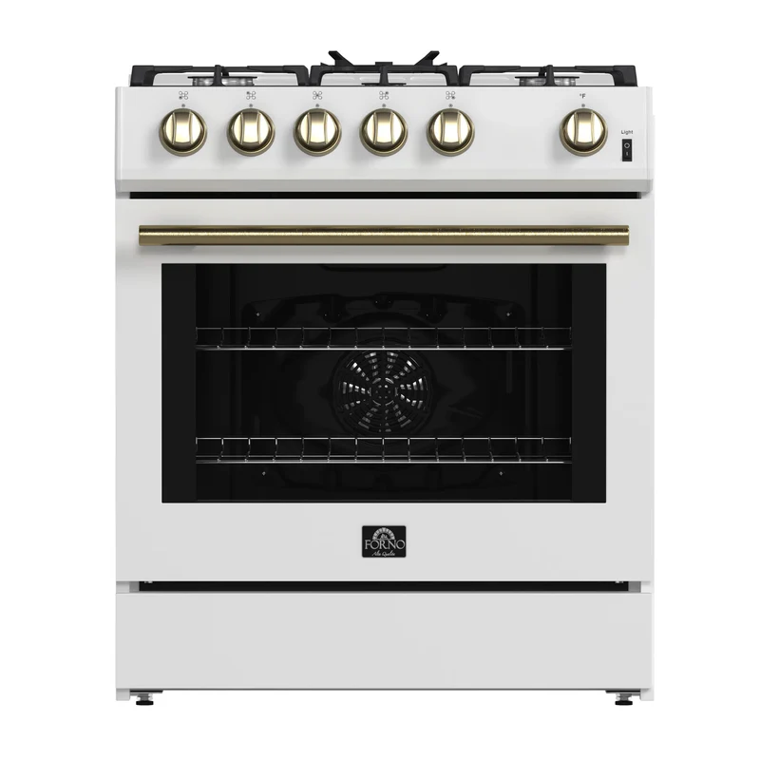
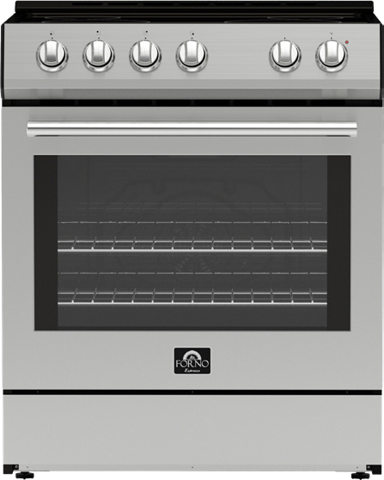
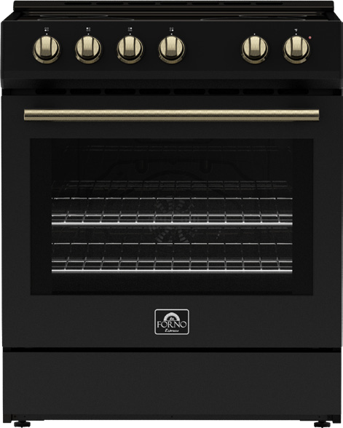
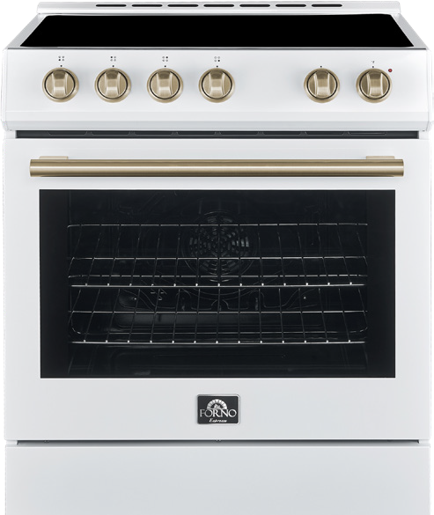
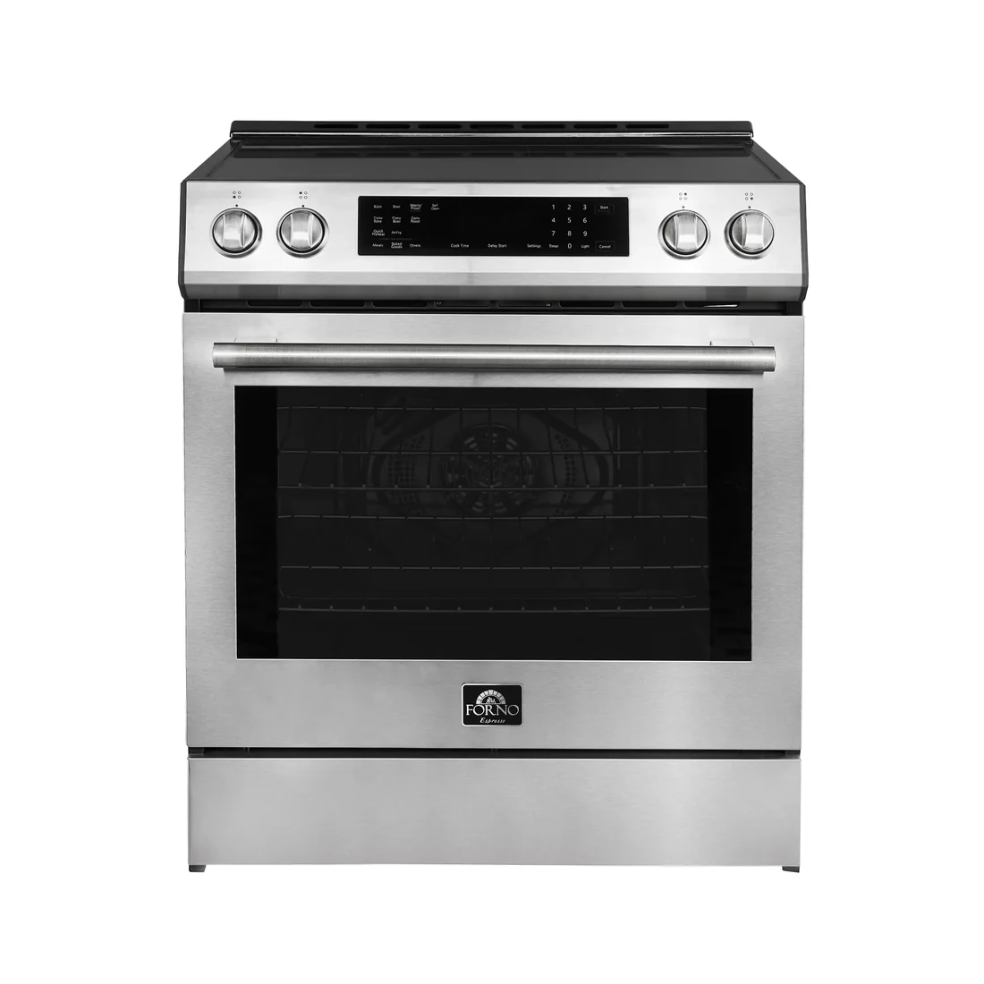
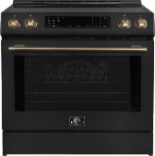
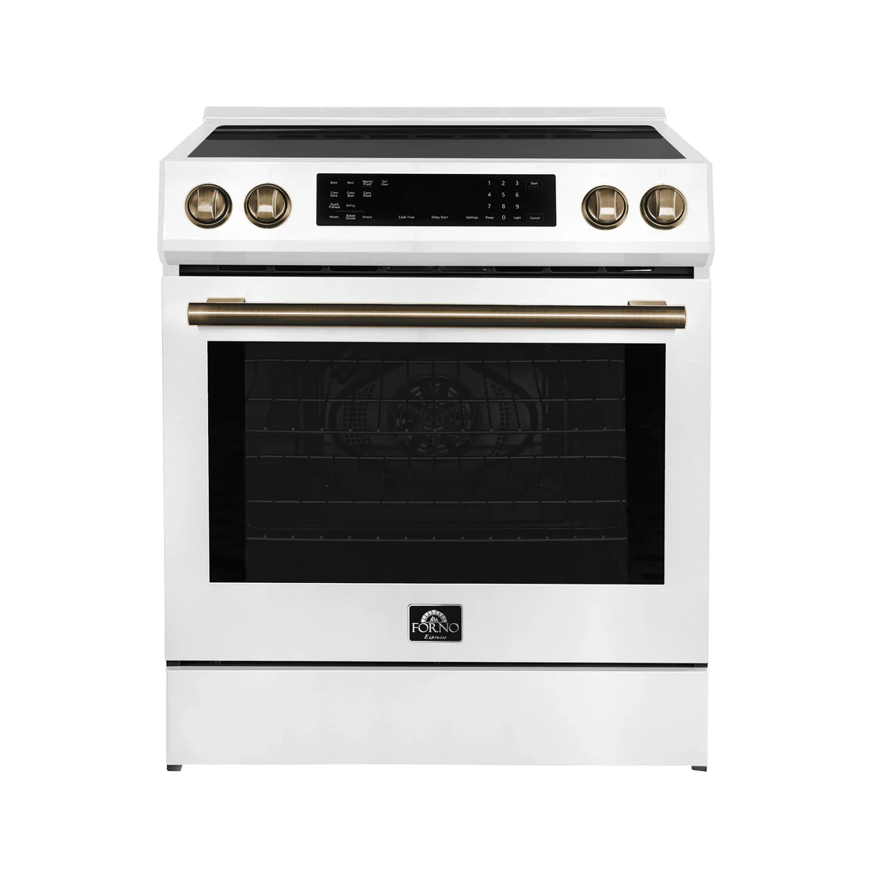
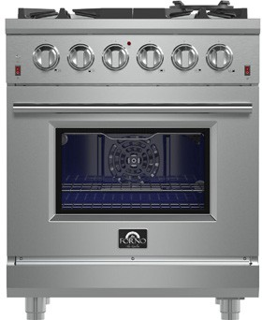
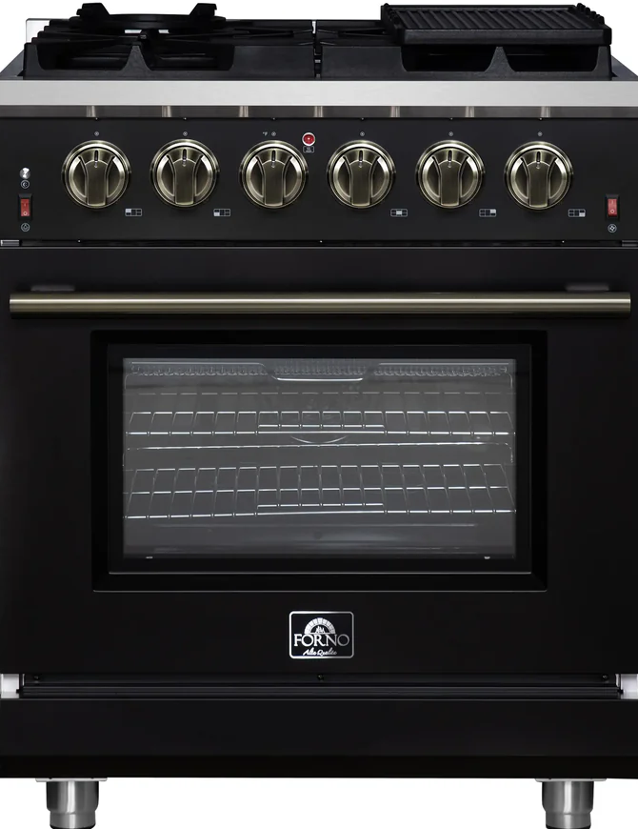
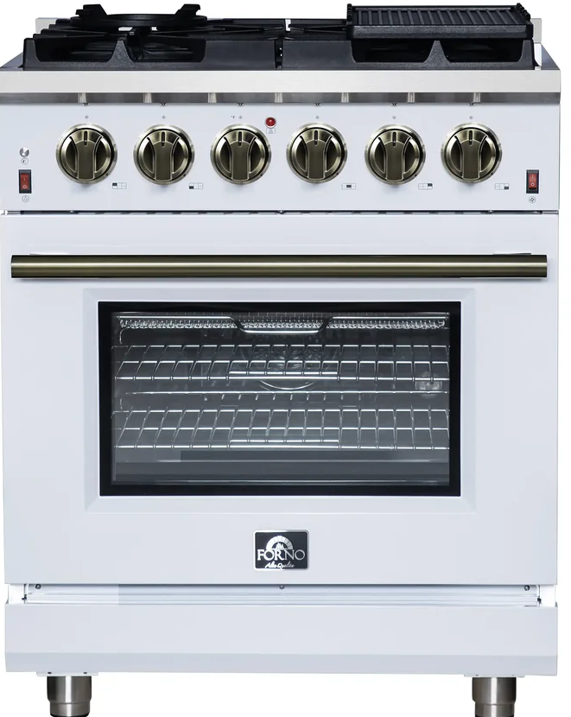
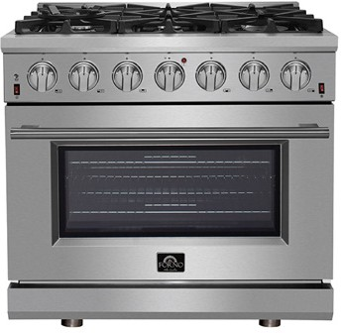
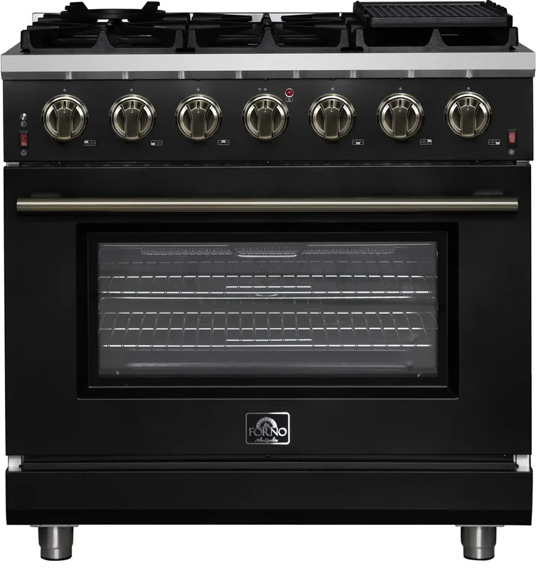
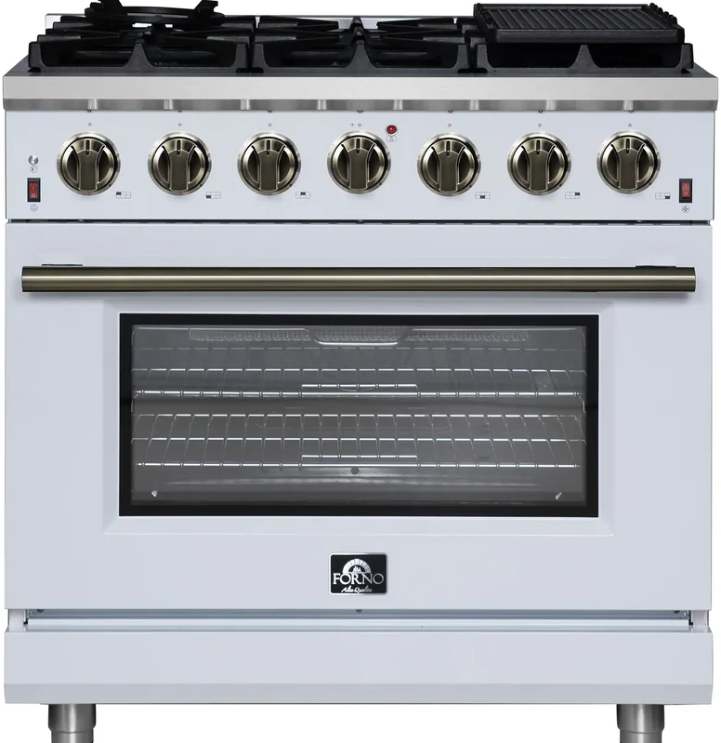
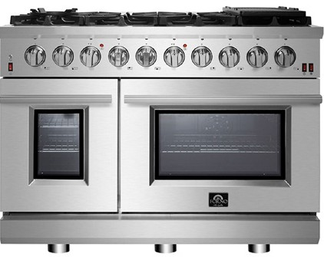
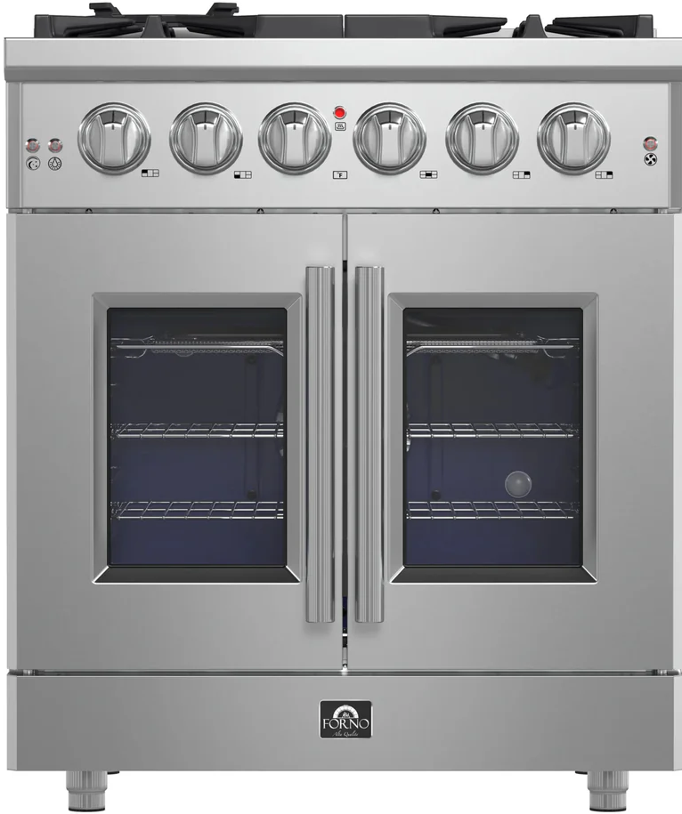
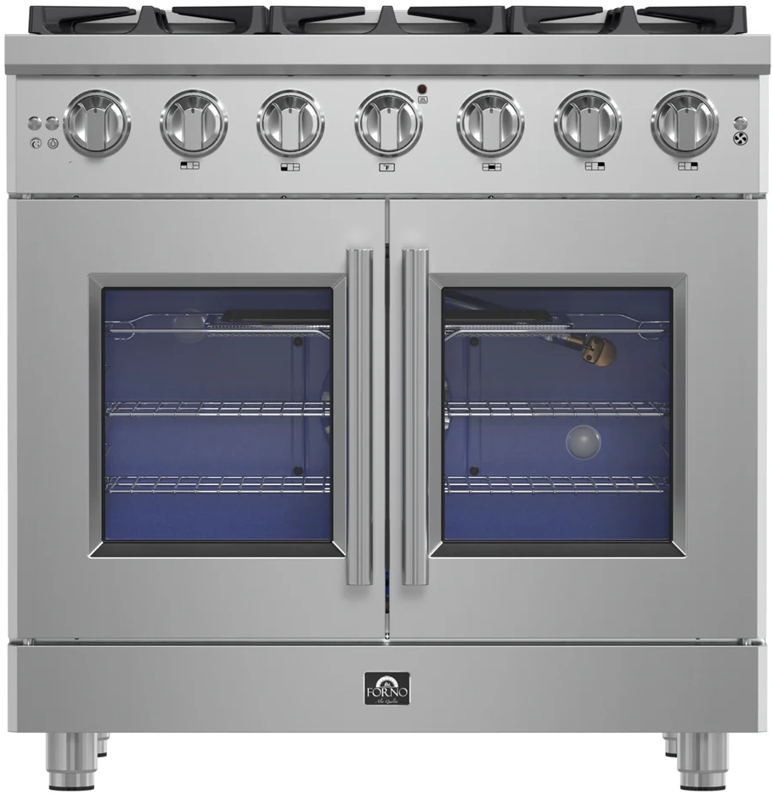
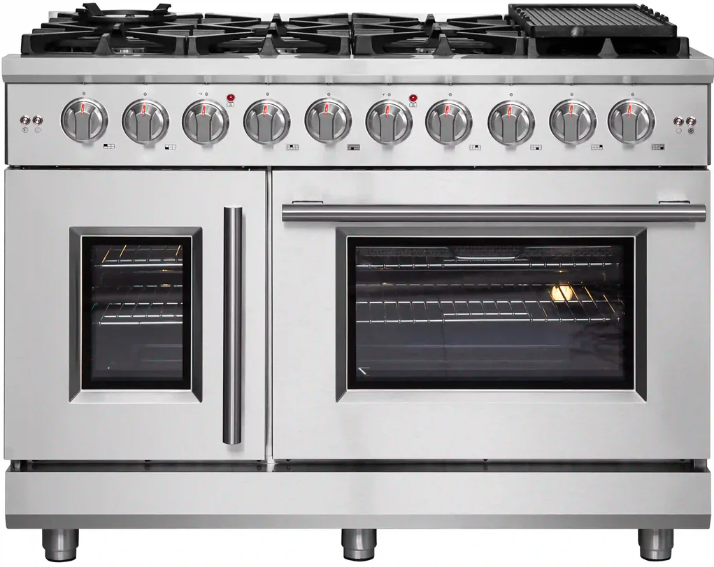
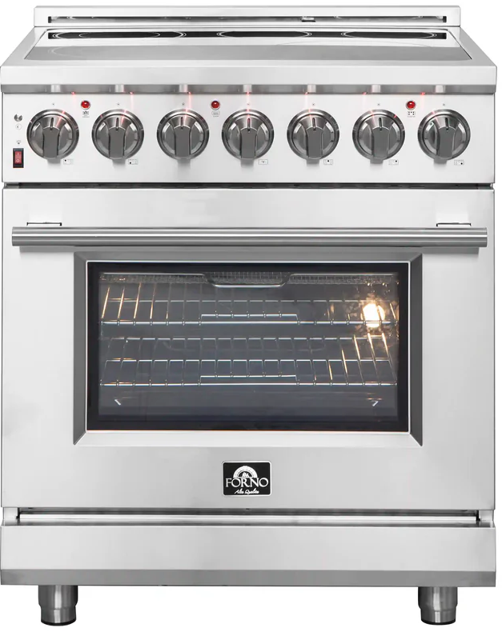
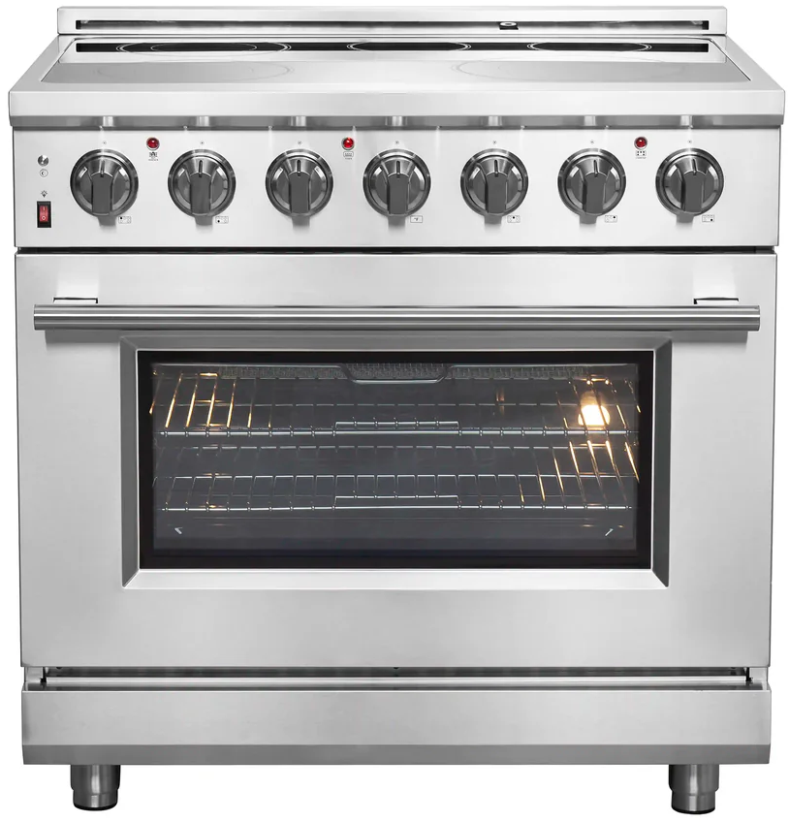
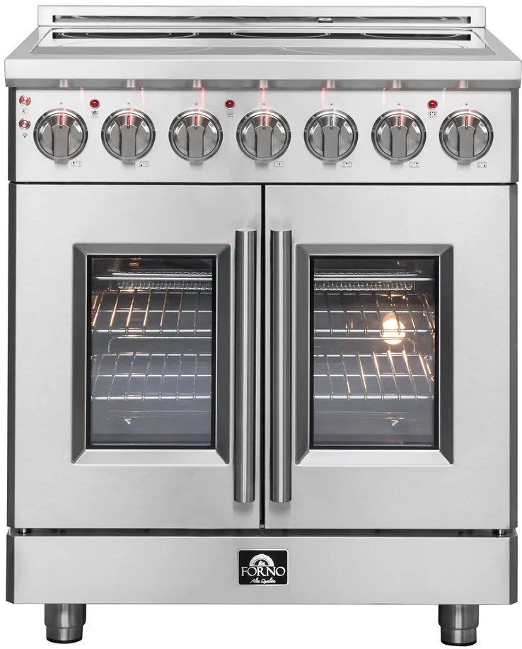
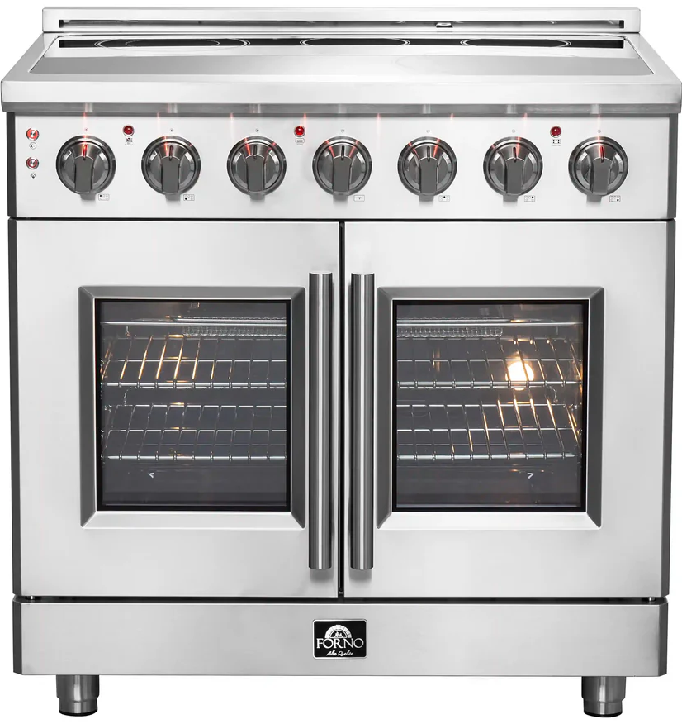
Cooking
ESPRESSO
$1,599/$1,799 MAP
FFSGS1116-30S/B/W
30” Gas Convection Range
$1,299/$1,499 PMAP
FFSEL6012-30S/B/W
30” Electric Convection
$1,799/$1,899
FFSIN0905-30S/B/W
30” Induction Convection Range
MASSIMO – GAS/DUAL FUEL
$1,999/$2,499PMAP
FFSGS6239-30 - Gas
FFSGS6125-30 – Dual Fuel
30” Convection -- Stainless
$2,499/$3,299PMAP
FFSGS6239-36 - Gas
FFSGS6125-36 – Dual Fuel
36” Convection -- Stainless
$3,699/$4,299 PMAP
FFSGS6239-48 - Gas
FFSGS6125-48 – Dual Fuel
48” Convection -- Stainless
$3,599 PMAP
FFSGS6439-30 - Gas
FFSGS6325-30 – Dual Fuel
30” Convection – French Door
$3,999 PMAP
FFSGS6439-36 - Gas
FFSGS6325-36 – Dual Fuel
36” Convection – French Door
$4,299 PMAP
FFSGS6439-48 - Gas
FFSGS6325-48 – Dual Fuel
48” Convection – French Door
MASSIMO – ELECTRIC
$2,099 PMAP
FFSEL6020-30
30” Electric Stainless
$2,999 PMAP
FFSEL6020-36
36” Electric Stainless
$2,699 PMAP
FFSEL6955-30
30” Electric Stainless
$3,199 PMAP
FFSEL6955-36
36” Electric Stainless

