Slide 1



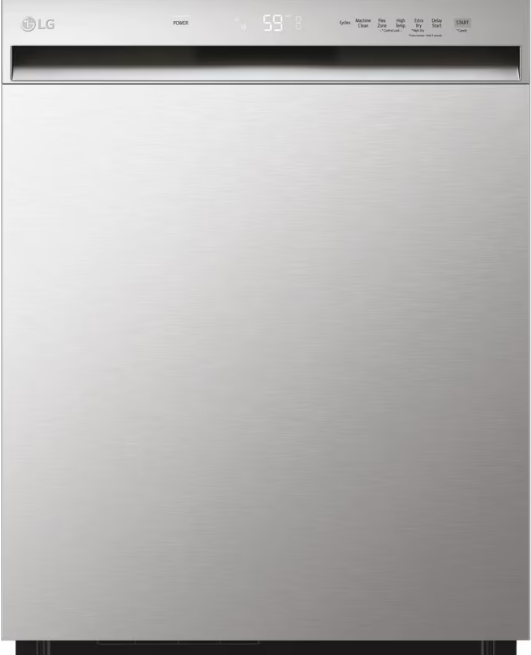

BF DOOR BUSTER DISHWASHER
LDFN3432T
24 Inch Wide QuadWash™ Front Control Dishwasher - Stainless Steel
Key features
With four spray arms instead of just two, Quad Wash® technology cleans dishes from multiple angles
15 Place-Setting
Dynamic Dry™ with LG’s 2-stage fan system
The LG NeveRust™ Stainless Steel Tub
LoDecibel™ Operation (50 dB)
NSF Certified
51% Margin
While Supplies Last: 200 in stock
Dimension (W x H x D) : 23 3/4" x 33 5/8" x 24 5/8"
Available Color
Stainless Steel

Slide 2
